Slide 1
Physic’s Informed Reservoir Model
Arofenitra Rarivonjy
Akmuhammet Gurbangeldiyev

Slide 2
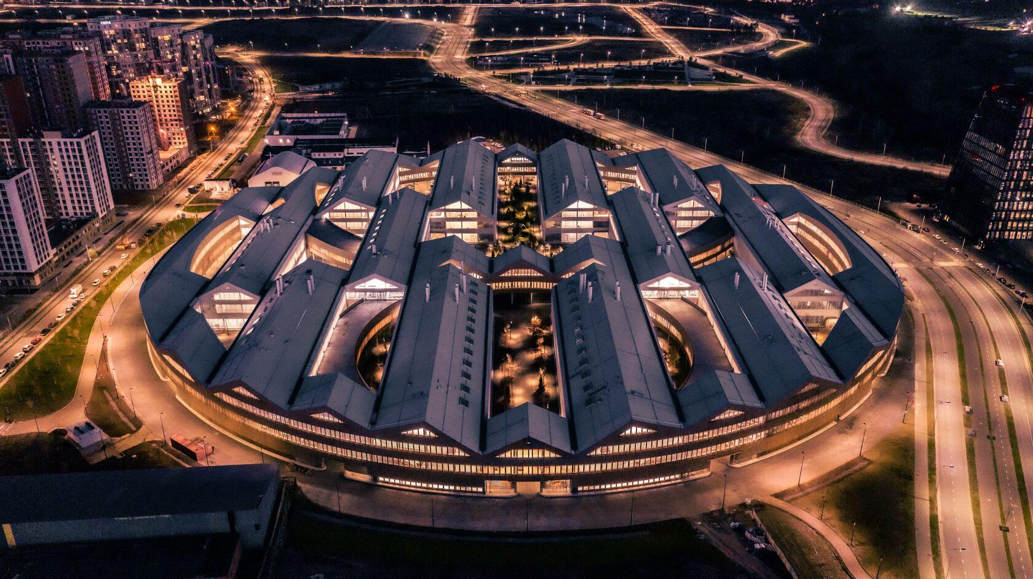

Physic’s Informed Reservoir Model
Course: Technology of Science Informed Machine Learning
Term 5, 2025
Arofenitra Rarivonjy
Akmuhammet Gurbangeldiyev
Presented by
Technology of Science Informed Machine Learning
Term 5 , 2025

Slide 3
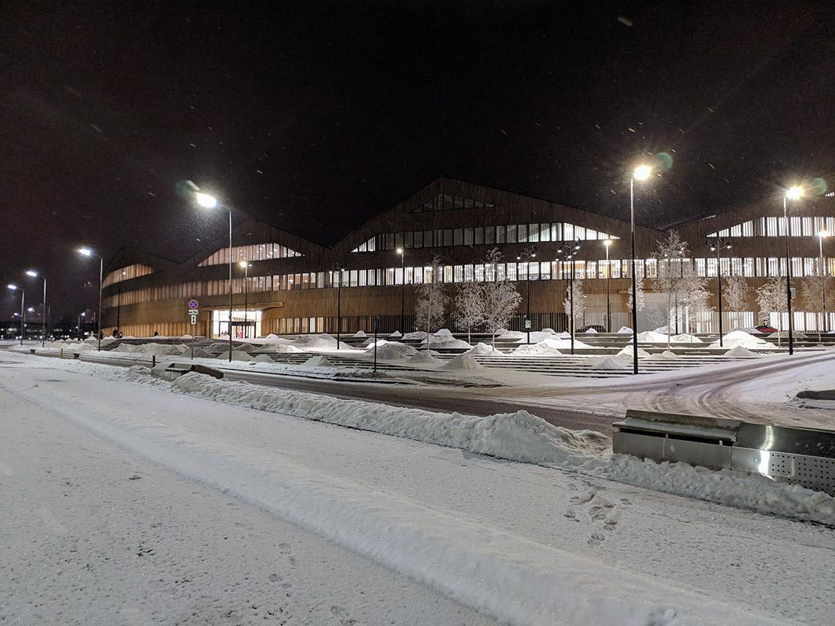


Meet the team
Akmuhammet Gurbangeldiyev
Arofenitra Rarivonjy
Technology of Science Informed Machine Learning
Term 5 , 2025

Slide 4
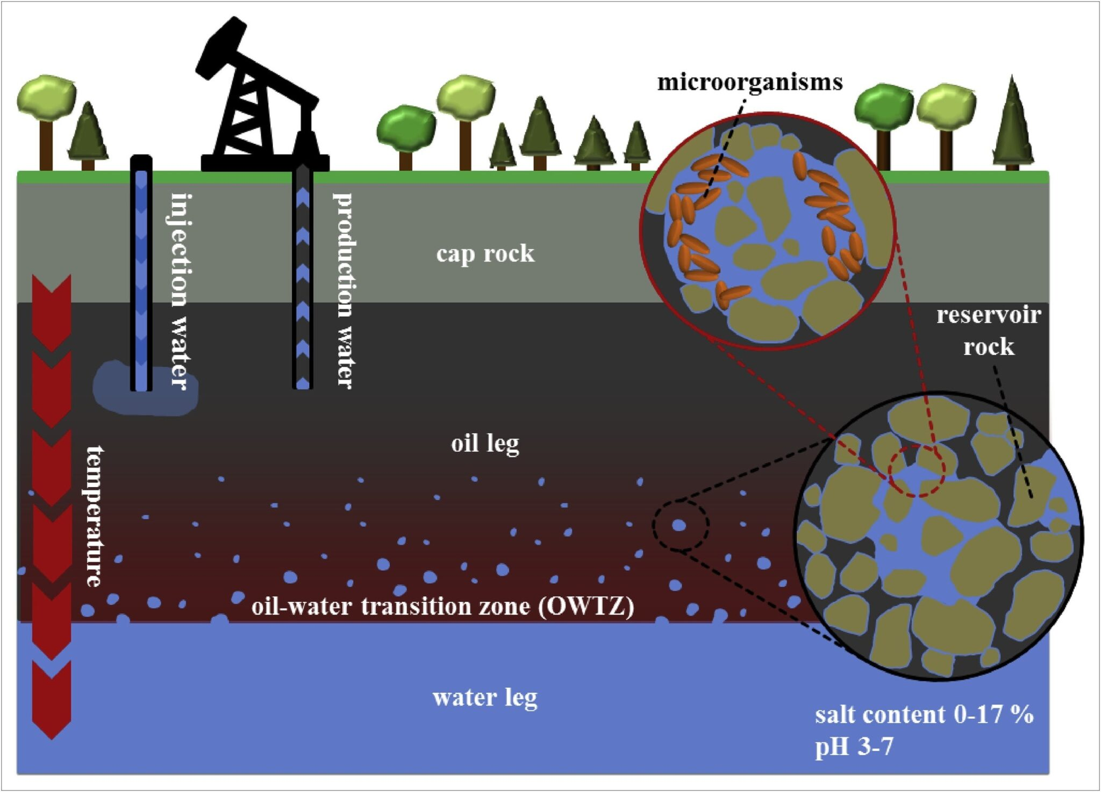
Introduction : Background
Reservoir simulation is critical for optimizing oil and gas production. PINN offers
Embedding physical laws directly into the loss function
Providing continuous solutions in space and time
Enabling efficient forward and inverse problem solving
Reducing computational cost for parametric studies
Technology of Science Informed Machine Learning
Term 5 , 2025

Slide 5

Develop a PINN framework for reservoir pressure prediction
Implement physics-informed loss functions incorporating PDEs and boundary conditions
Train and validate models for single-well and multi-well scenarios
Compare performance and analyze pressure field characteristics
Scope of the Research :
This study focuses on 2D horizontal reservoir flow with incompressible fluid assumptions. The governing equation is the diffusivity equation, which describes pressure propagation in porous media.
Technology of Science Informed Machine Learning
Term 5 , 2025

Slide 6
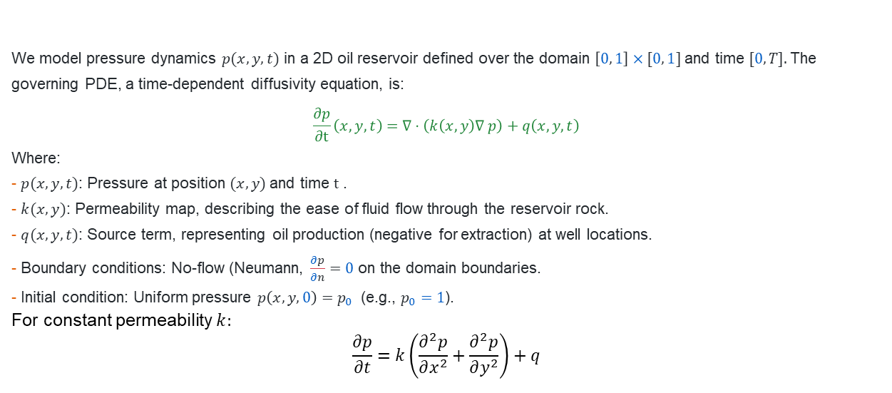
2. Methodology
We model pressure dynamics $p(x, y, t)$ in a 2D oil reservoir defined over the domain $\left[0, 1\right]×[0, 1]$and time $[0, T].$The governing PDE, a time-dependent diffusivity equation, is:
$$\frac{∂p}{∂t}\left(x,y,t\right)=∇⋅\left(k\left(x, y\right)∇ p\right)+q\left(x, y, t\right)$$
Where:
- $p(x, y, t)$: Pressure at position $(x, y)$and time $t$ .
- $k(x, y)$: Permeability map, describing the ease of fluid flow through the reservoir rock.
- $q(x, y, t)$: Source term, representing oil production (negative for extraction) at well locations.
- Boundary conditions: No-flow (Neumann, $\frac{∂p}{∂n}=0$ on the domain boundaries.
- Initial condition: Uniform pressure $p\left(x,y,0\right)=p_{0}$ (e.g., $p_{0}=1$).
For constant permeability $k:$
$$\frac{∂p}{∂t}=k\left(\frac{∂^{2}p}{∂x^{2}}+\frac{∂^{2}p}{∂y^{2}}\right)+q$$
Technology of Science Informed Machine Learning
Term 5 , 2025

Slide 7
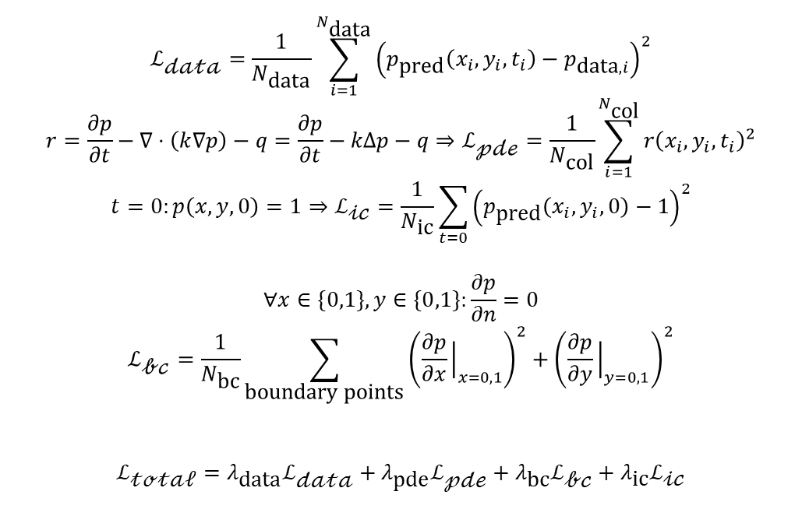
Loss Function
$$ℒ_{\text{𝒹𝒶𝓉𝒶}}=\frac{1}{N_{\text{data}}}\sum_{i=1}^{N_{\text{data}}}{{\left(p_{\text{pred}}\left(x_{i},y_{i},t_{i}\right)−p_{\text{data},i}\right)}^{2}}$$
$$r=\frac{∂p}{∂t}−∇⋅\left(k∇p\right)−q=\frac{∂p}{∂t}−kΔp−q⇒ℒ_{\text{𝓅𝒹ℯ}}=\frac{1}{N_{\text{col}}}\sum_{i=1}^{N_{\text{col}}}{r{\left(x_{i},y_{i},t_{i}\right)}^{2}}$$
$$t=0:p\left(x,y,0\right)=1⇒ℒ_{\text{𝒾𝒸}}=\frac{1}{N_{\text{ic}}}\sum_{t=0}{{\left(p_{\text{pred}}\left(x_{i},y_{i},0\right)−1\right)}^{2}}$$
$$∀x∈\{0,1\},y∈\{0,1\}:\frac{∂p}{∂n}=0$$
$$ℒ_{\text{𝒷𝒸}}=\frac{1}{N_{\text{bc}}}\sum_{\text{boundary} \text{points}}{{\left(\frac{∂p}{∂x}{\left.​\right|}_{x=0,1}\right)}^{2}}+{\left(\frac{∂p}{∂y}{\left.​\right|}_{y=0,1}\right)}^{2}$$
$$ℒ_{\text{𝓉ℴ𝓉𝒶𝓁}}=λ_{\text{data}}ℒ_{\text{𝒹𝒶𝓉𝒶}}+λ_{\text{pde}}ℒ_{\text{𝓅𝒹ℯ}}+λ_{\text{bc}}ℒ_{\text{𝒷𝒸}}+λ_{\text{ic}}ℒ_{\text{𝒾𝒸}}$$
Data Loss:
PDE Loss:
IC Loss:
BC Loss:
Total Loss:
Technology of Science Informed Machine Learning
Term 5 , 2025

Slide 8
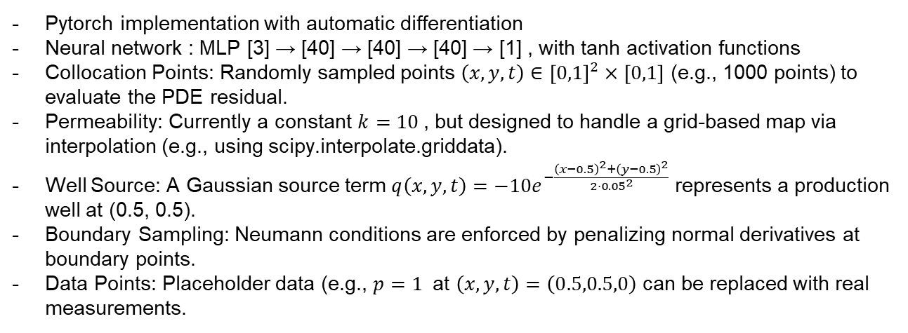
Implementation
Pytorch implementation with automatic differentiation
Neural network : MLP [3] → [40] → [40] → [40] → [1] , with tanh activation functions
Collocation Points: Randomly sampled points $\left(x,y,t\right)∈{\left[0,1\right]}^{2}×\left[0,1\right]$ (e.g., 1000 points) to evaluate the PDE residual.
Permeability: Currently a constant $k=10$, but designed to handle a grid-based map via interpolation (e.g., using scipy.interpolate.griddata).
Well Source: A Gaussian source term $q\left(x,y,t\right)=−10e^{−\frac{{\left(x−0.5\right)}^{2}+{\left(y−0.5\right)}^{2}}{2⋅{0.05}^{2}}}$ represents a production well at (0.5, 0.5).
Boundary Sampling: Neumann conditions are enforced by penalizing normal derivatives at boundary points.
Data Points: Placeholder data (e.g., $p=1$ at $\left(x,y,t\right)=\left(0.5,0.5,0\right)$ can be replaced with real measurements.
Technology of Science Informed Machine Learning
Term 5 , 2025

Slide 9
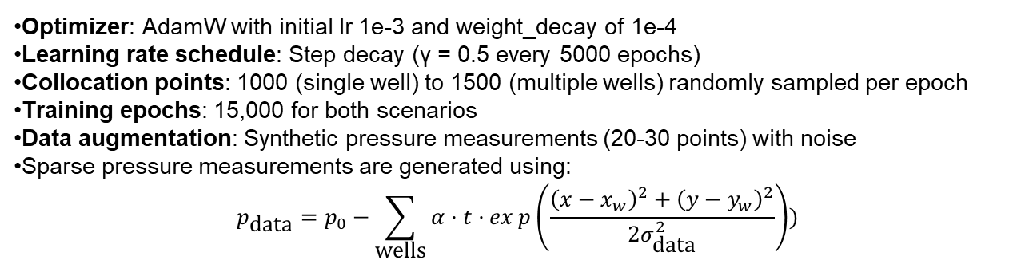
Implementation
Optimizer: AdamW with initial lr 1e-3 and weight_decay of 1e-4
Learning rate schedule: Step decay (γ = 0.5 every 5000 epochs)
Collocation points: 1000 (single well) to 1500 (multiple wells) randomly sampled per epoch
Training epochs: 15,000 for both scenarios
Data augmentation: Synthetic pressure measurements (20-30 points) with noise
Sparse pressure measurements are generated using:
$$p_{\text{data}}=p_{0}−\sum_{\text{wells}}{α}⋅t⋅exp\left(\frac{{\left(x−x_{w}\right)}^{2}+{\left(y−y_{w}\right)}^{2}}{2σ_{\text{data}}^{2}}\right))$$
Technology of Science Informed Machine Learning
Term 5 , 2025

Slide 10
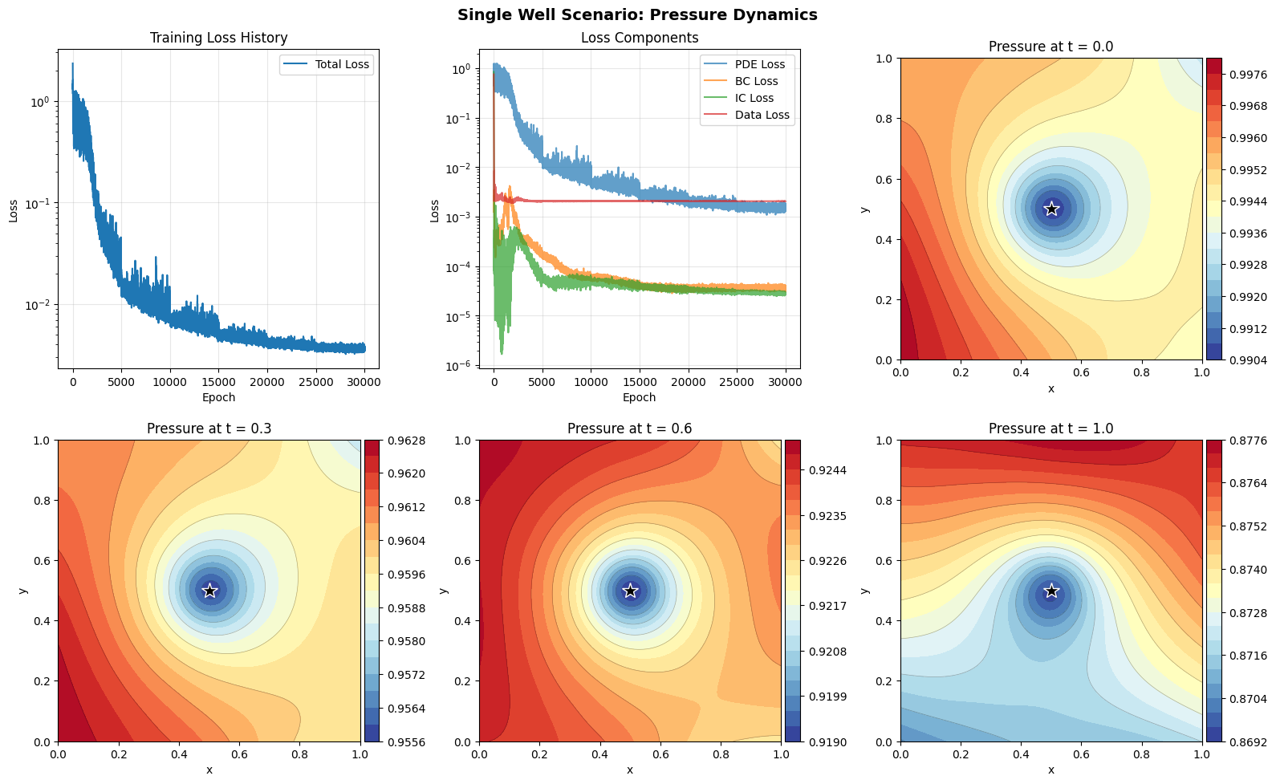
3. Results : Single Well Scenario
Technology of Science Informed Machine Learning
Term 5 , 2025

Slide 11
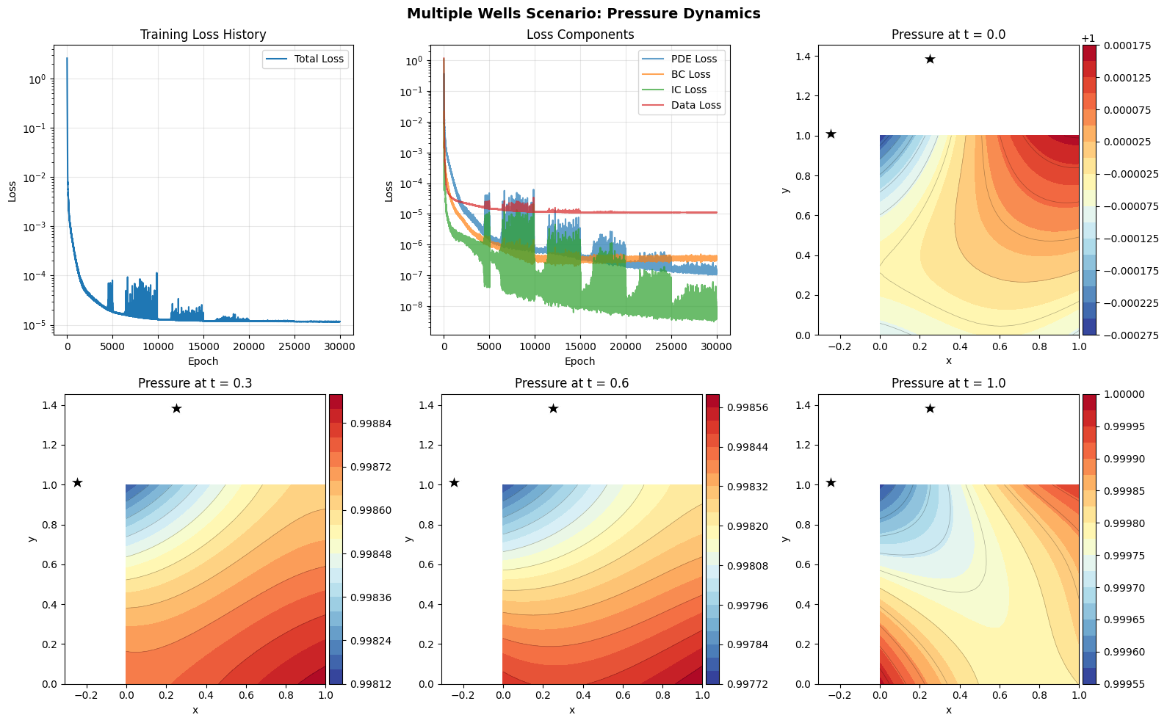
2 Wells Outside
Technology of Science Informed Machine Learning
Term 5 , 2025

Slide 12
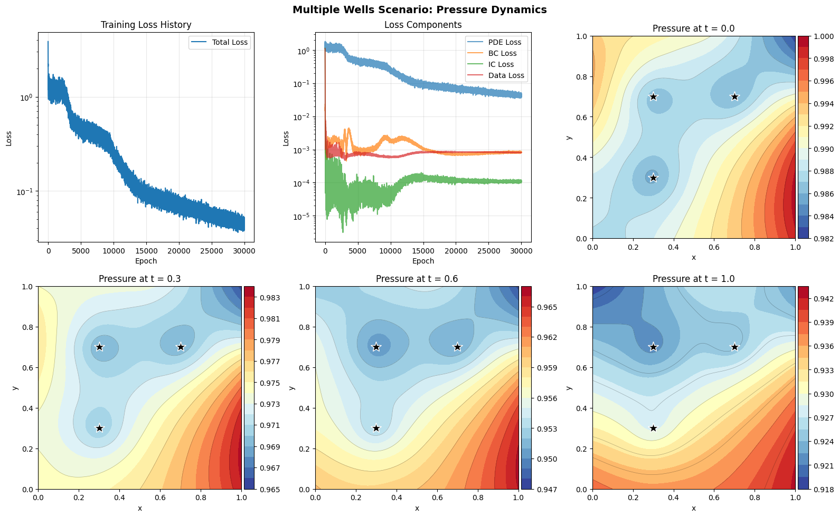
3 Wells scenario
Technology of Science Informed Machine Learning
Term 5 , 2025

Slide 13
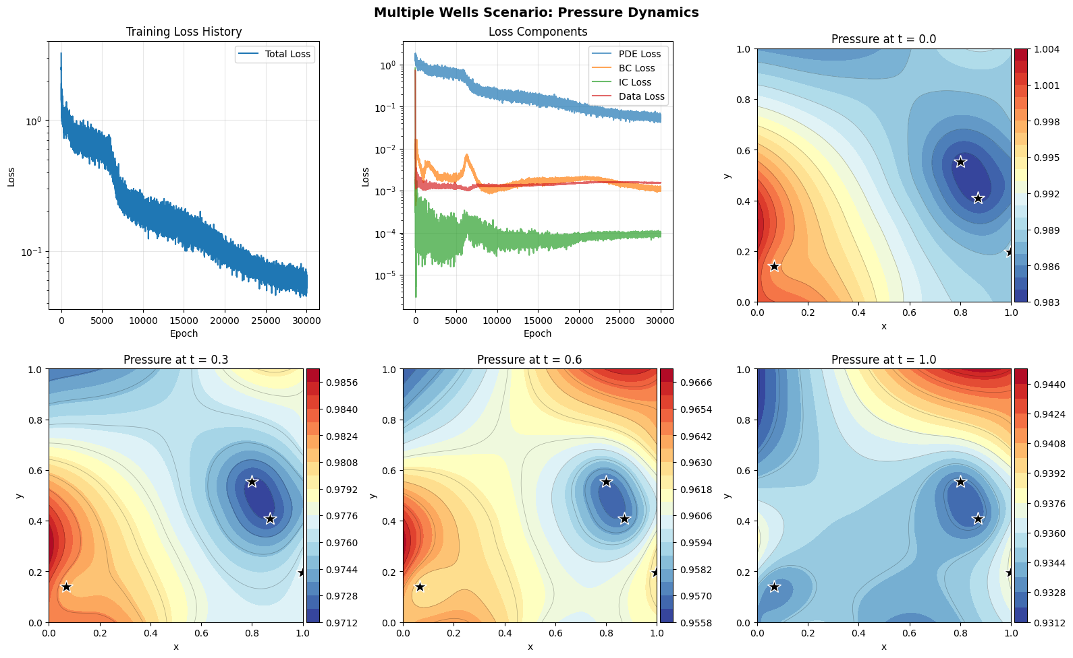
4 wells scenario
Technology of Science Informed Machine Learning
Term 5 , 2025

Slide 14
Comparison of scenarios
Metric | 1 well | 2 wells | 3 wells | 4 wells
Total Loss | 3.748e-3 | 1.2e-5 | 4.25e-2 | 0.055145
Training time | 15 min | 16 min | 15 min | 14 min
Min Pressure (t=1.0) | 0.8692 | 0.999955 | 0.918 | 0.9312
Pressure Gradient | Uniform Radial | Complex | Complex | Complex
Data Points Used | 20 | 30 | 30 | 30
Collocation Points | 1000 | 1500 | 1500 | 1500
Technology of Science Informed Machine Learning
Term 5 , 2025

Slide 15
4. Discussion and Analysis : Strength of PINN
Physics Integration : Embedding the diffusivity equation into the learning process
Mesh-Free Solution (unlike finite element method)
Handling complex well configurations
Inverse Problem capability (Estimating k(x,y) from pressure)
4. Discussion and Analysis : Limitations of PINN
Computational Cost
Loss balancing (hyperparameters finetuning)
Can stuck in local minima
Sharp gradient near well
Technology of Science Informed Machine Learning
Term 5 , 2025

Slide 16
PINN VS Traditional Methods
Aspect | PINN | Finite Difference
Setup Time | Low (no meshing) | Medium (grid setup)
Accuracy | Good (with sufficient training) | High (stable schemes)
Computational Cost | Medium (training) | Low (single solve)
Inverse Problems | Natural | Difficult (adjoint)
Adaptivity | Easy (resampling) | Hard (regridding)
Data Integration | Seamless | Post-processing
Technology of Science Informed Machine Learning
Term 5 , 2025

Slide 17
Connection to PINO Framework
This work implements PINN (point-wise evaluation) but shares philosophy with Physics-Informed Neural Operators (PINO):
PINN (this work):
Learns mapping: (x, y, t) → p
Requires retraining for new permeability k or well configuration
PINO (future extension):
Learns operator: k, q → p (function → function)
Generalizes to new permeability maps without retraining
Combines Fourier Neural Operators (FNO) with physics loss
Technology of Science Informed Machine Learning
Term 5 , 2025

Slide 18
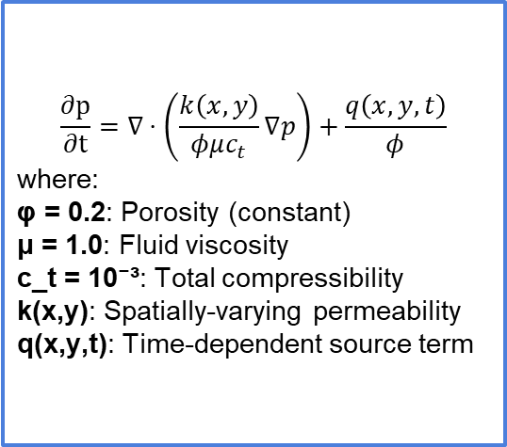
Extension to more complex cases
Sine activation networks (improved spectral propriety)
Heterogeneous permeability fields
Mixed well configurations
Curriculum learning (begin from 1 well to several wells)
$$\frac{\text{∂}\text{p}}{\text{∂}\text{t}}=∇⋅\left(\frac{k\left(x,y\right)}{φμc_{t}}∇p\right)+\frac{q\left(x,y,t\right)}{φ}$$
where:
φ = 0.2: Porosity (constant)
μ = 1.0: Fluid viscosity
c_t = 10⁻³: Total compressibility
k(x,y): Spatially-varying permeability
q(x,y,t): Time-dependent source term
Technology of Science Informed Machine Learning
Term 5 , 2025

Slide 19
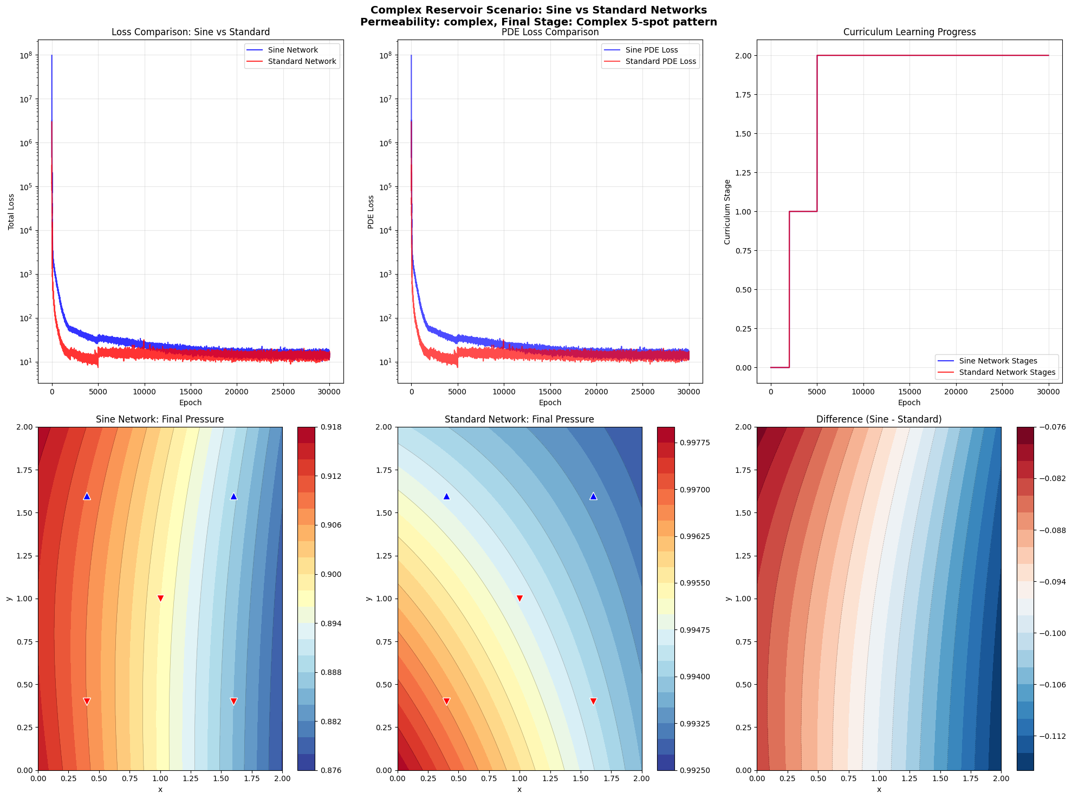
Sine vs standard
Total Loss: 12.456
PDE: 12.453490,
BC: 0.002154,
IC: 0.000729
LR: 3.78e-07,
Network: sine
Total Loss: 13.327844
PDE: 13.327836,
BC: 0.000005,
IC: 0.000002
LR: 3.78e-07,
Network: standard
Technology of Science Informed Machine Learning
Term 5 , 2025

Slide 20
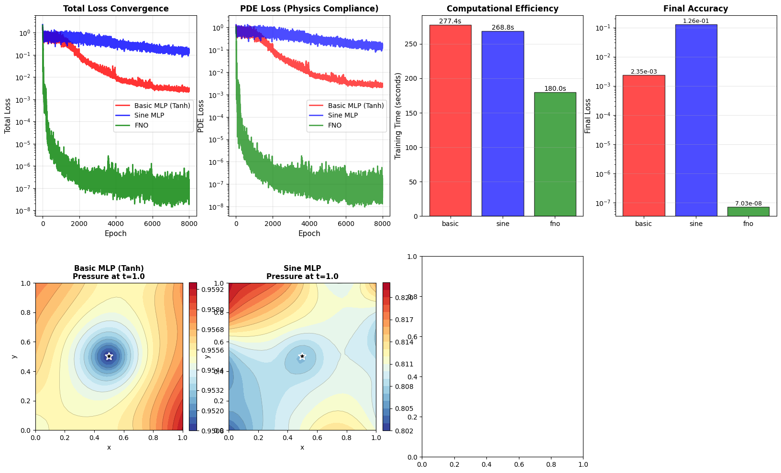
Sine vs standard
Technology of Science Informed Machine Learning
Term 5 , 2025

Slide 21
Summary
This Project presents the development and application of Physics-Informed Neural Networks (PINNs) for predicting pressure dynamics in oil reservoirs. The approach combines neural network learning with physical laws (partial differential equations) to model fluid flow in porous media. Two scenarios are investigated: single-well and multi-well configurations. Results demonstrate that PINNs can effectively capture complex pressure distributions while respecting underlying physics.
Technology of Science Informed Machine Learning
Term 5 , 2025

Slide 22
5. Conclusion
- We successfully provide mathematical formulation, PINN Implementation, Physics informed loss, single well and multiple well success and visualization.
Physics integration enable accurate predictions, mesh-free approach, scalable from single to multiple well, converge in 30 000 epochs, interpretable.
Practical Implications : Real time forecasting, uncertainty quantifications, optimizations, history matching, etc .
5. Future Research Directions
Model enhancements in several cases
Use of advanced architectures NN or NO
Use in real case study
Technology of Science Informed Machine Learning
Term 5 , 2025

Slide 23
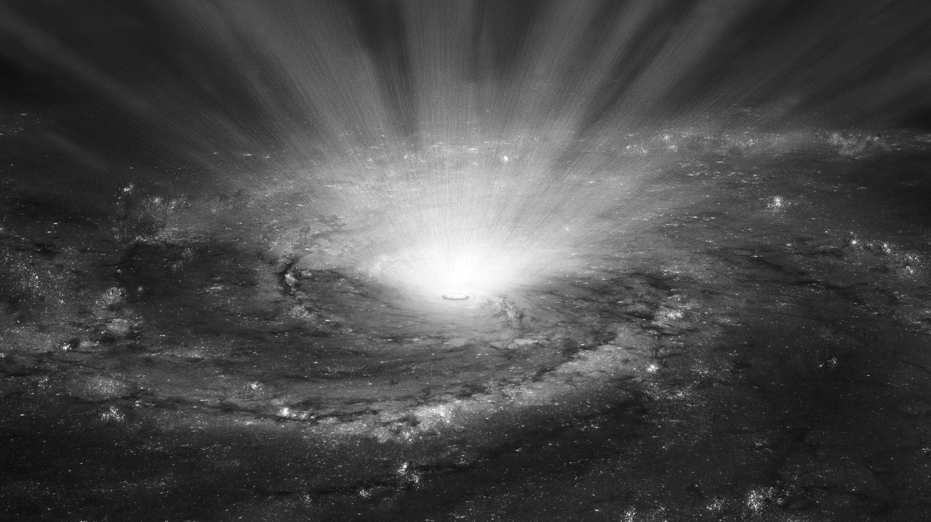


Slide 24
References
Li, Z., Kovachki, N., Azizzadenesheli, K., Liu, B., Bhattacharya, K., Stuart, A., & Anandkumar, A. (2021). Fourier Neural Operator for Parametric Partial Differential Equations. arXiv:2010.08895.
Li, Z., Zheng, H., Kovachki, N., Jin, D., Chen, H., Liu, B., Azizzadenesheli, K., & Anandkumar, A. (2023). Physics-Informed Neural Operator for Learning Partial Differential Equations. arXiv:2111.03794.
Raissi, M., Perdikaris, P., & Karniadakis, G. E. (2019). Physics-informed neural networks: A deep learning framework for solving forward and inverse problems involving nonlinear partial differential equations. Journal of Computational Physics, 378, 686-707.
Aziz, K., & Settari, A. (1979). Petroleum Reservoir Simulation. Applied Science Publishers.
Wang, S., Teng, Y., & Perdikaris, P. (2021). Understanding and mitigating gradient flow pathologies in physics-informed neural networks. SIAM Journal on Scientific Computing, 43(5), A3055-A3081.

